Slide 1



Internet of Things (IoT) Information Display
Benjamin Daszkiewicz & Jacob Nading
Advised by Dr. Aleksander Malinowski

Slide 2
Contents
Introduction
Problem Statement
Functionality
Minimum requirements
Additional
System hardware flowchart
SDLC Flowcharts (subsystems)
Parts list
Research & prior work
Existing projects/patents
Project history
Efforts completed to date
Schedule of deadlines
Division of labor
Near future
References

Slide 3
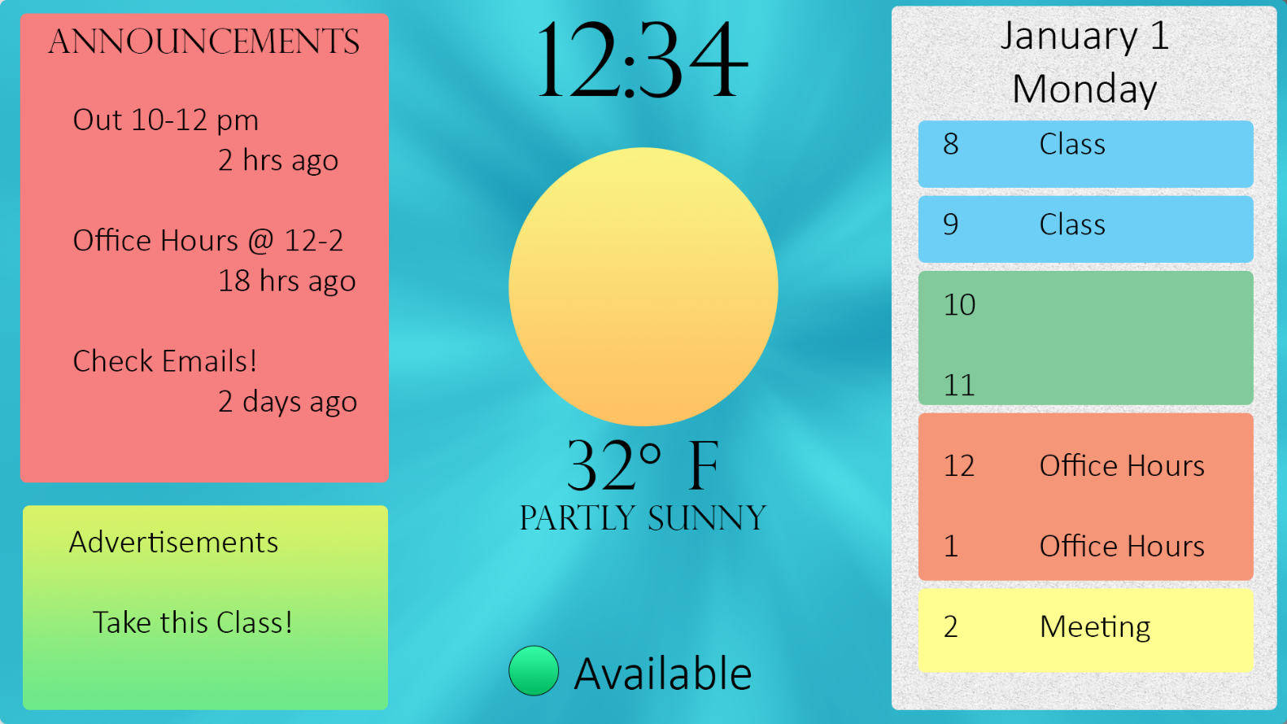
Introduction
Modern technology-driven world
Use of technology for constant improvement
Busy people, volatile schedules
Need the ability to communicate updating schedules
Share information with coworkers or students
Seamless synchronization between systems
The IoT Information Display

Slide 4
Problem Statement
Idea for project by Dr. Malinowski
Increase ease of communication between students and professors
Busy schedules
Encourage use of office hours
Clumsy web alternatives
Difficulty in making multiple schedules apparent to others
Abrupt change in schedule causes multilayered problem of informing those affected

Slide 5
Contents
Introduction
Problem Statement
Functionality
Minimum requirements
Additional
System hardware flowchart
SDLC Flowcharts (subsystems)
Parts list
Research & prior work
Existing projects/patents
Project history
Efforts completed to date
Schedule of deadlines
Division of labor
Near future
References

Slide 6
Minimum Functionality Requirements
Daily calendar data
Short memos/announcements
Advertisements
Paging function with geofencing
Current and forecast weather data
Attractive, user-friendly interface
Notes:
Expand upon each of these in the future with pictures and more in-depth discussion on how each one functions

Slide 7
Additional Proposed Functionality
Sensors
Camera
Door sensor
Online Expansion
Remote usability
Get notified on certain updates in an easy-to-read format
See a broader week schedule without having to look in-person
Push notifications to phones and other devices for better spreading of information
E-mail and/or text instructor from Display
Appointment Scheduler

Slide 8
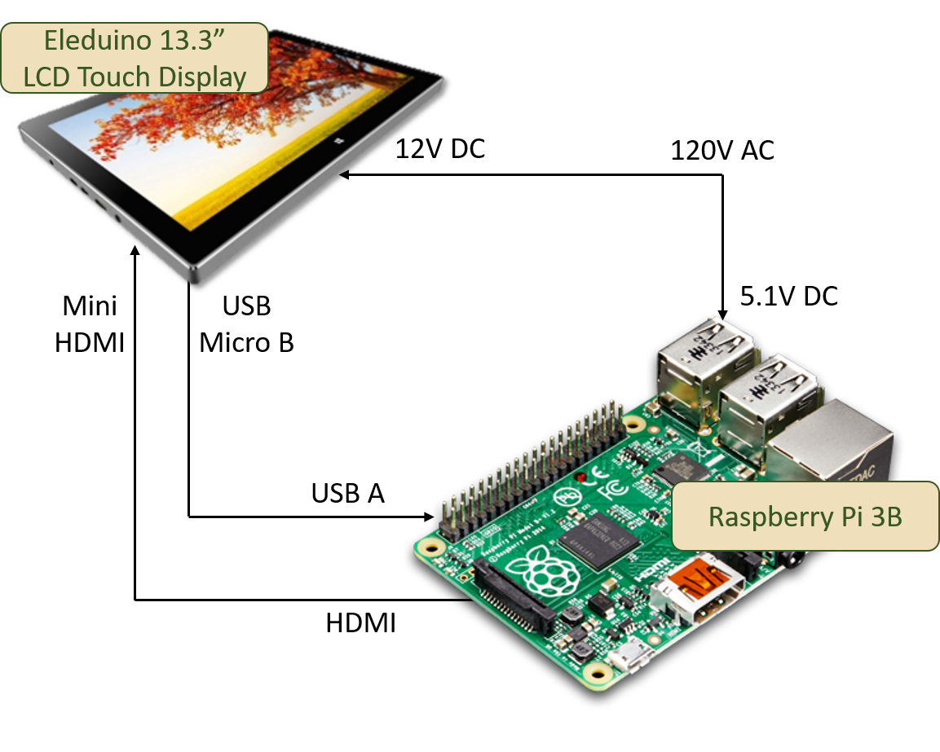
System Hardware Flowchart

Slide 9

Modes of Operation
On
System is powered and functioning
Off
System is not supplied with power
Standby
Advertisements or
Powered but blank screen
Reduce power consumption
Subsystems

Slide 10
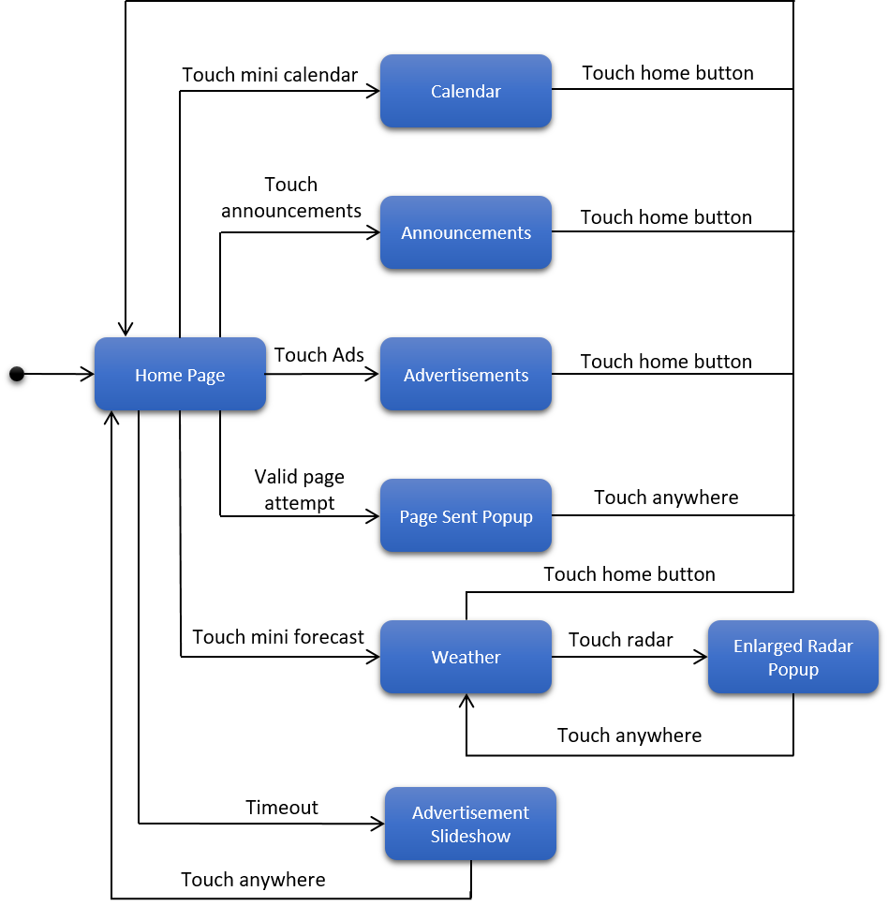
High Level State Transition Diagram
Breaks down steady states of software and transition triggers

Slide 11

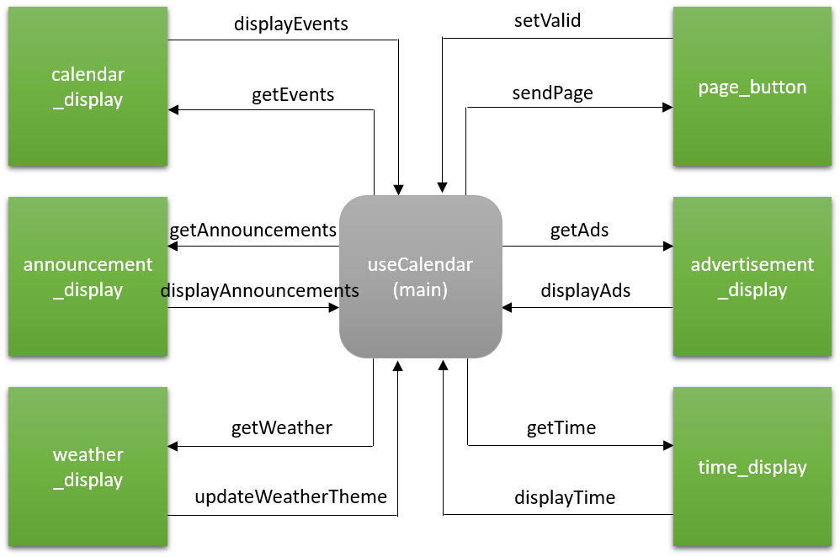
Context Data Flow Diagram
Shows data transfer between main function and subsystems

Slide 12
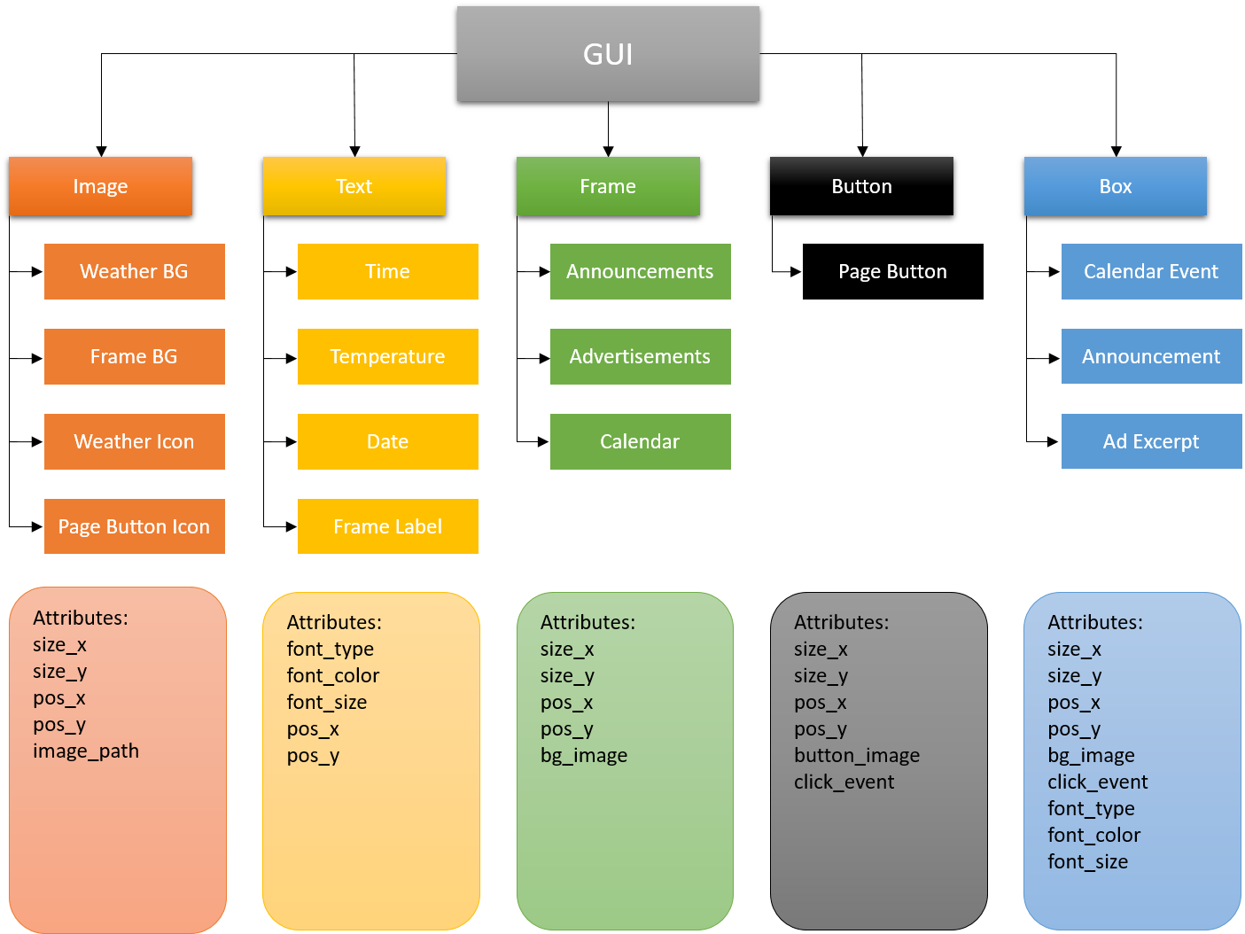
GUI Design Model
Breaks down GUI elements and major attributes

Slide 13
Contents
Introduction
Problem Statement
Functionality
Minimum requirements
Additional
System hardware flowchart
SDLC Flowcharts (subsystems)
Parts list
Research & prior work
Existing projects/patents
Project history
Efforts completed to date
Schedule of deadlines
Division of labor
Near future
References

Slide 14
Parts List
Qty | Item Description | Source | Price/Unit | Price
1 | Eleduino 13.3” 1080P IPS Capacitive Touch Display (sky black) | Amazon.com | $198.00 | $189.00
2 | CanaKit Raspberry Pi 3 Kit | Amazon.com | $49.99 | $99.98
2 | SanDisk Ultra 8GB Class 10 UHS-I MicroSDHC | Amazon.com | $9.99 | $19.98
1 | Rankie Micro HDMI to HDMI Cable, 10 Feet | Amazon.com | $9.99 | $9.99
1 | Micro USB Cable, 3 Pack 10 ft Braided High Speed USB 2.0 A Male to Micro B | Amazon.com | $10.99 | $10.99
 |  |  | Subtotal: | $329.94

Slide 15
Contents
Introduction
Problem Statement
Functionality
Minimum requirements
Additional
System hardware flowchart
SDLC Flowcharts (subsystems)
Parts list
Research & prior work
Existing projects/patents
Project history
Efforts completed to date
Schedule of deadlines
Division of labor
Near future
References

Slide 16
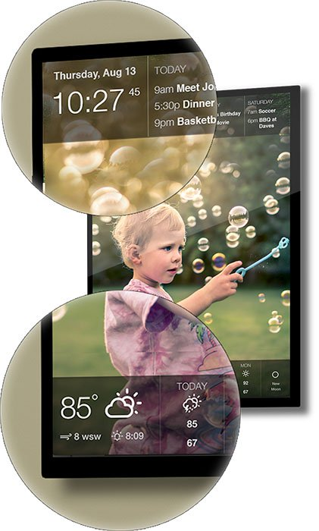
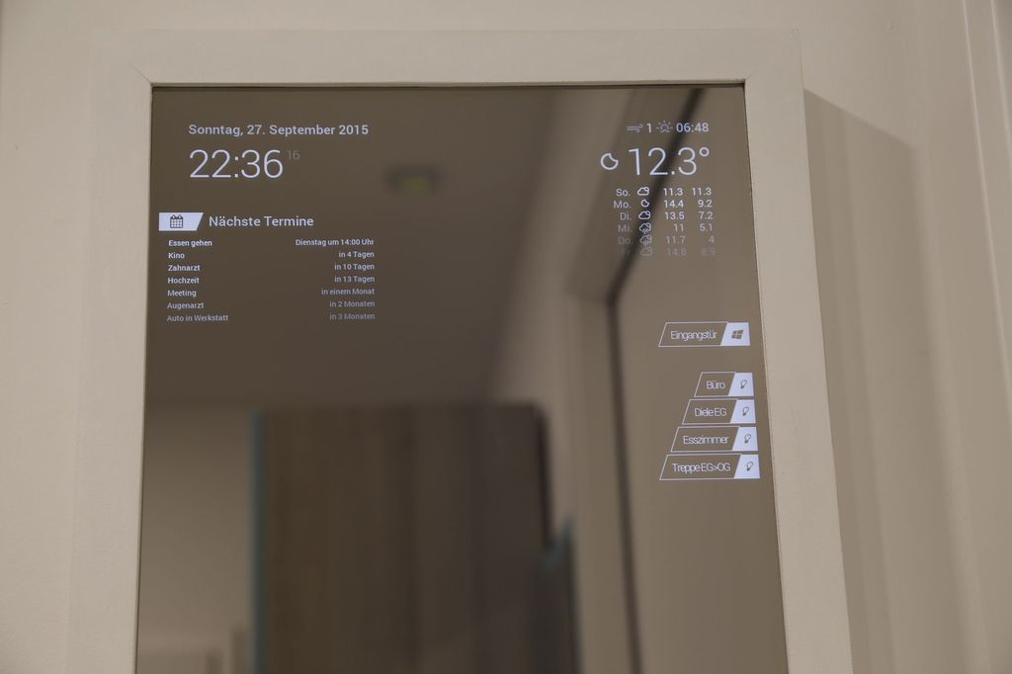
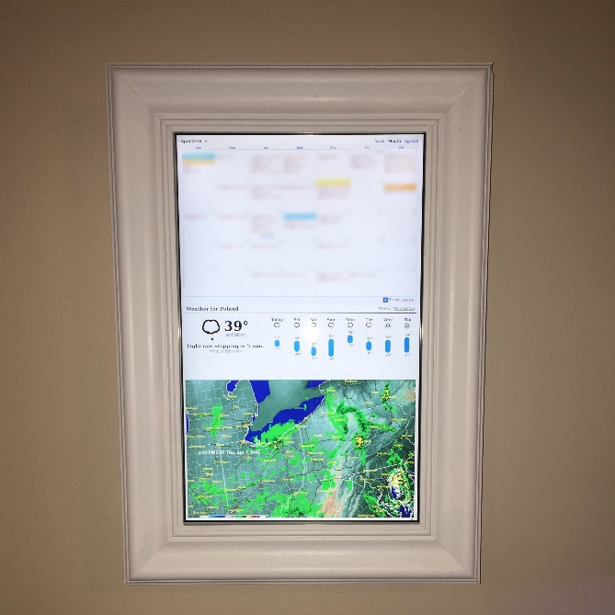
Existing Products/Projects
DAKboard
Customizable Interface
Photos, Calendar, and Weather
Raspberry Pi Framed Informational Display
Monitor enclosed within a frame
Buttons on side to toggle between sections
Smart Mirror
(Amazon) Alexa Option
2-way mirror with Monitor attached

Slide 17
Existing Patents
Content display device with sensors https://patents.google.com/patent/WO2016061626A1/en?q=smart
Smart interactive billboard device https://patents.google.com/patent/US20050021393A1/en?q=smart
Raspberry Pi based smart home control device with touch display https://patents.google.com/patent/CN106789459A/en?q=smart

Slide 18
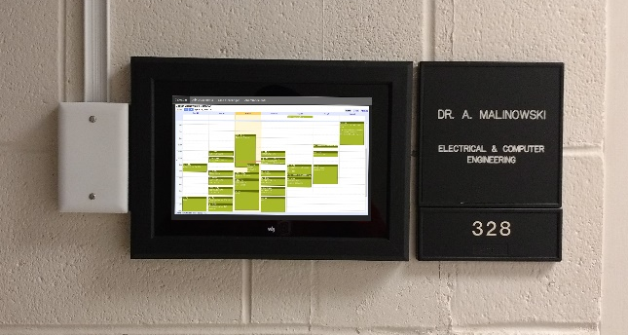
Previous Work (2016-2017)
Cole Lindeman & Jason Morris
IoT Smart Calendar
User and door sensors
Browser based interface
php, HTML, etc.
Relies on default view for calendar

Slide 19
Contents
Introduction
Problem Statement
Functionality
Minimum requirements
Additional
System hardware flowchart
SDLC Flowcharts (subsystems)
Parts list
Research & prior work
Existing projects/patents
Project history
Efforts completed to date
Schedule of deadlines
Division of labor
Near future
References

Slide 20
Efforts Completed to date
Design
Interactions between user and device
Display layout
Functionality and added features
Research
Analyze other interactive / informative displays
Parts list/ordering
Availability of display
Self instruction in wxPython module, Twitter, and Google Calendar API
Graphics & Software
Some graphical aspects of the home screen already created
Environment
Raspbian Desktop or Xubuntu
Python v2.7
Environment installed, configured, and tested on hardware

Slide 21
Contents
Introduction
Problem Statement
Functionality
Minimum requirements
Additional
System hardware flowchart
SDLC Flowcharts (subsystems)
Parts list
Research & prior work
Existing projects/patents
Project history
Efforts completed to date
Schedule of deadlines
Division of labor
Near future
References

Slide 22
Schedule of Deadlines (Fall 2017)
Date | Item Due / Requirement Met
Fall 2017
11/16/17 | Proposal presentation draft *
11/30/17 | Project proposal and presentation *
12/7/17 | Website with proposal presentation and report *
12/7/17 | Non-functional, rough layout prototype for display written in Python
12/7/17 | Majority of graphical project aspects created
* Department deliverable deadline
Project completion milestone

Slide 23
Schedule of Deadlines (Spring 2018)
Date | Item Due / Requirement Met
Spring 2018
2/16/18 | Working calendar and announcements prototype (API work) with home screen and functional weather icon
2/23/18 | Added advertisements and display mounted
3/9/18 | Student expo registration *
3/16/18 | Paging functionality (Geofence work)
3/23/18 | Weather/radar screen
3/29/18 | Final report *
4/5/18 | Student Expo poster *
4/19/18 | Final presentation draft *
5/1/18 | All materials completed and uploaded to website *
* Department deliverable deadline
Project completion milestone

Slide 24
Contents
Introduction
Problem Statement
Functionality
Minimum requirements
Additional
System hardware flowchart
SDLC Flowcharts (subsystems)
Parts list
Research & prior work
Existing projects/patents
Project history
Efforts completed to date
Schedule of deadlines
Division of labor
Near future
References

Slide 25
Division of Labor
Benjamin Daszkiewicz
Jacob Nading
GUI Programming
Main page script will pull returned values of all other functions for display
Calendar section
Google Calendar API
Weather functionality
Weather change based on current conditions
Forecast page/radar display
Graphic components
Icon/component design
Layout and visual design
Announcements section
Twitter API
Paging system
Geofencing interface
Geofencing app selection

Slide 26
Contents
Introduction
Problem Statement
Functionality
Minimum requirements
Additional
System hardware flowchart
SDLC Flowcharts (subsystems)
Parts list
Research & prior work
Existing projects/patents
Project history
Efforts completed to date
Schedule of deadlines
Division of labor
Near future
References

Slide 27
Near Future
Create solution to screen power dissipation
Measure power consumption and amperage drawn
Create ”dummy” interface using wxPython module
Finish major graphics images for use in GUI homescreen
Come up with mounting solution
Should be designed with screen cooling in mind

Slide 28
Contents
Introduction
Problem Statement
Functionality
Minimum requirements
Additional
System hardware flowchart
SDLC Flowcharts (subsystems)
Parts list
Research & prior work
Existing projects/patents
Project history
Efforts completed to date
Schedule of deadlines
Division of labor
Near future
References

Slide 29
References – existing projects
IoT Smart Calendar – Jason Morris, Cole Lindeman
http://ee.bradley.edu/projects/proj2017/iotsc/index.html
Archambault, Michael. “DAKboard Is a Customizable Wall Display for Photos, Calendar Events, and Weather.” PetaPixel. N.p., 19 Aug. 2015. Web. https://petapixel.com/2015/08/19/dakboard-is- a-customizable-wall- display-for- photos-calendar- events-and- weather.
Eagan, Ben. “Smart Mirror (with Optional Alexa).” Hacster.io. N.P., 8 April. 2017. Web. https://www.hackster.io/ben-eagan/smart- mirror-with- optional-alexa- 874d43.
Kmccb. “Raspberry Pi Framed Informational Display - Google Calendar, Weather, and More” Imgur. N.p., 07 Apr. 2016. Web. https://imgur.com/gallery/z94Vr.

Slide 30
References – information
Google Calendar API
https://developers.google.com/google-apps/calendar/
Twitter API
https://developer.twitter.com/en/docs
https://pypi.org/project/twitter/
wxPython
https://www.wxpython.org/
wxPython Wiki
https://wiki.wxpython.org/

Slide 31



Questions

